Slide 1
Objectives
In this session, you will learn to:
  Classify business organizations
  Identify the process of creating a company
  Understand the features of F11 key
  Understand the features of F12 key
  Identify the process of creating ledgers
  Identify the accounting processes in Service organization
  Record transactions in Service organization
Notes:
Share the session objectives with the students.

Slide 2
Classifying Business Organizations
Service is defined as work done for others, in lieu of a price.
Services do not have any physical form or substance.
An organization providing services is called a service organization.
Nature of a service organization:
  Service organizations provide services at the point of consumption by the customer.
  Services are perishable.
  Customer interaction is higher.
  Service organizations are more labor intensive than manufacturing organizations.
Notes:
Share the session objectives with the students.

Slide 3

Identifying the Process of Creating a Company
Notes:
Share the session objectives with the students.

Slide 4
Understanding F11: Features
F11:Company Features button:
  Is used to modify the various features of a company.
  Is available in most applications of Tally.ERP 9.
  Is specific to the current company only and thus each company may have different features activated.
  Is divided into:
    Accounting Features
    Statutory and Taxation Features
    Tally.NET Features
Notes:
Share the session objectives with the students.

Slide 5
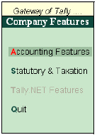
Understanding F11: Features (Contd.)
The following figure shows the Company Features menu.
Notes:
Share the session objectives with the students.

Slide 6
Understanding F12: Configure
F12:Configure button:
  Is used to configure settings for various applications available in Tally.ERP 9.
  Affects all companies maintained in the same data directory.
Accts/Inventory configuration:
  Is used to set the details that should display in the account masters.
  Is available in the Accounts and Inventory master screens through the F12:Configure button .
  Can be modified as per the requirement.
Notes:
Share the session objectives with the students.

Slide 7
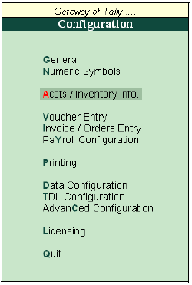
Understanding F12: Configure (Contd.)
The following figure shows the Configuration menu.
Notes:
Share the session objectives with the students.

Slide 8
Identifying the Process of Creating Ledgers
All financial entries are made using ledger account heads.
Every transaction/voucher can be related to a ledger account head to which it belongs.
Ledgers that have transactions of the same nature are classified under one group.
A group is a collection of ledgers which have similar transactions.
Notes:
Share the session objectives with the students.

Slide 9
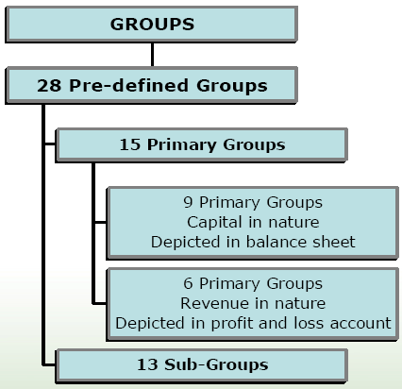
Identifying the Process of Creating Ledgers (Contd.)
The following figure shows the Groups.
Notes:
Share the session objectives with the students.

Slide 10
Identifying the Process of Creating Ledgers (Contd.)
Tally.ERP is pre-programmed with variety of accounting vouchers, each designed to perform a specific job.
Tally.ERP has a set of shortcut keys to access vouchers easily.
The standard vouchers are:
  Contra Voucher
  Payment Voucher
  Receipt Voucher
  Journal Voucher
  Sales Invoice
  Purchase Invoice
Notes:
Share the session objectives with the students.

Slide 11
Identifying the Process of Creating Ledgers (Contd.)
Contra Voucher:
  As per accounting rules, contra entry is a transaction indicating transfer of funds from:
    Cash account to Bank account
    Bank account to Cash account
    One Bank account to another Bank account
Payment Voucher:
  Is used to account payment transactions.
Receipt Voucher:
  Is used to account transactions involving receipt of money.
Journal Voucher:
  Is used to account transactions that involve adjustment of debit and credit accounts.
Notes:
Share the session objectives with the students.

Slide 12
Identifying the Process of Creating Ledgers (Contd.)
Sales Invoice:
  Is a voucher created when goods/services are sold, which the customer (debtor) use as a proof of purchase made.
Purchase Invoice:
  Is a bill issued by the supplier for the purchases made by the customer.
Notes:
Share the session objectives with the students.

Slide 13
Identifying the Accounting Processes in Service Organization
Service Organization:
  Maintains regular account books.
  Generally do no follow a standard pricing policy for all customers at all times and the performance is evaluated at the end of a market cycle.
  Focuses on effective utilization of human resources.
Notes:
Share the session objectives with the students.

Slide 14
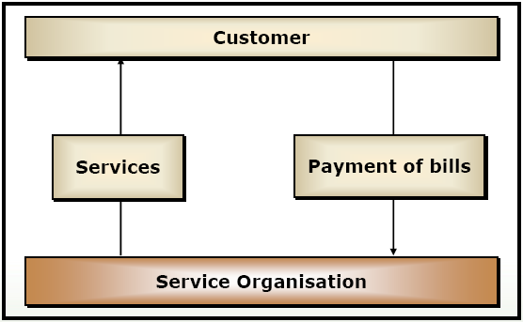
Identifying the Accounting Processes in Service Organization (Contd.)
The following figure shows accounting in a service organization.
Notes:
Share the session objectives with the students.

Slide 15

Recording Transactions in Service Organization
Notes:
Share the session objectives with the students.

Slide 16
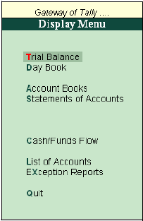
Recording Transactions in Service Organization (Contd.)
Trial Balance:
  Is a statement of all account balances at a specified date.
  Is prepared to check the arithmetical accuracy of the entries.
The following figure shows the Display Menu - Trial Balance.
Notes:
Share the session objectives with the students.

Slide 17

Recording Transactions in Service Organization (Contd.)
Notes:
Share the session objectives with the students.

Slide 18
Summary
In this session, you learned that:
  An organization providing services is called a service organization.
  The nature of a service organization is:
    Service organizations provide services at the point of consumption by the customer.
    Services are perishable.
    Customer interaction is higher.
    Service organizations are more labor intensive than manufacturing organizations.
  F11:Company Features button is used to modify the various features of a company.
  F12:Configure button is used to configure settings for various applications available.

Slide 19
Summary (Contd.)
  Every transaction/voucher can be related to a ledger account head to which it belongs.
  Ledgers that have transactions of the same nature are classified under one group.
  Tally.ERP is pre-programmed with variety of accounting vouchers, each designed to perform a specific job.
  The standard vouchers are:
    Contra Voucher
    Payment Voucher
    Receipt Voucher
    Journal Voucher
    Sales Invoice
    Purchase Invoice

